Slide 1
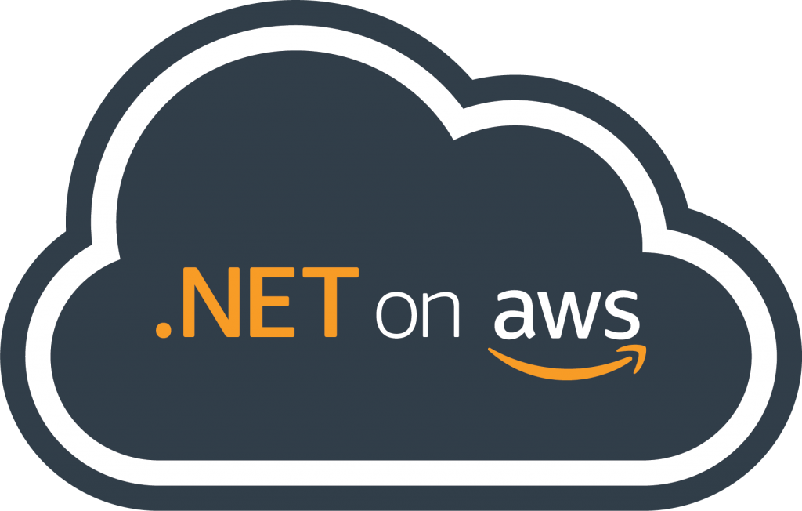



Building and Running .NET Apps on the Cloud Choose your own adventure
Isaac Levin
.NET Developer Advocate
@isaacrlevin

Slide 2
What .NET developers ask me about AWS
Does AWS support .NET?
Does AWS provide tools for .NET developers?
How can I host my .NET application on AWS?
How can I containerize my .NET application?
How can I move from .NET Framework to .NET?
How can I break my .NET monolith?

Slide 3
The most important key takeaway
.NET

Slide 4
Does AWS support .NET?

Slide 5
AWS Toolkit for Visual Studio 2023
Microservice Extractor for .NET
Never ending commitment to .NET
Core WCF Contributor
ARM64 support with Graviton2
AWS .NET deployment tool
Porting Assistant for .NET
AWS Elastic Beanstalk with .NET 5
.NET Core 3.1 on Lambda
App2Container
Amplify CLI .NET support
.NET Lambda base image
AWS Toolkit for Rider
AWS Elastic Beanstalk with .NET Core 3.1
AWS Toolkit for Visual Studio Code
AWS CDK with .NET
Windows Server 2019
Lambda Support for PowerShell Core
Lambda Layers
Dedicated Host Enhancement Tag-On
Windows Server 1803
SQL Server 2019
Sessions Manager
AWS X-Ray .NET Core Support
EC2 Windows on Bare Metal/Hyper-V AMI
DynamoDB Accelerator SDK for .NET
Hyper-V support in SMS
.NET Core 2.1 Linux AMIs
Customer Adoption
Windows Deep Learning AMI
SQL 2017 AMI AL2/Ubuntu
Application-consistent Snapshots through VSS
.NET Core & PowerShell on AL2/Ubuntu
SQL Server 2017
.NET Core 2.1 on Lambda
.NET on Lambda & Codebuild
Windows for Lightsail
Trusted Advisor checks for Windows
EC2 Systems Manager
X-Ray .NET SDK
Microsoft SharePoint 2016 (Marketplace)
Amazon ECS for Windows Containers
EC2 Dedicated Hosts (BYOL)
Windows Server 2016
AWS Directory Service
SQL Server 2016
Windows Server & EC2
EC2 Dedicated Instances (BYOL)
Windows Server 2012
EC2 Run Command
SQL Server
Windows
Server 2003
Windows
Server 2008 R2
SQL Server 2012
Microsoft SCVMM Plug-in
AWS Tools for Windows PowerShell
.NET
SQL Server 2005
SQL Server 2008 R2
Amazon RDS adds SQL Server
App Modernization
Microsoft SCOM plug-in release
Toolkit for Visual Studio
SDK for .NET
WS 2008 & SQL Server 2008
2008
2010
2012
2014
2016
2018
2020
Today
Notes:
AWS has nearly 15 years of experience supporting .NET and has provided the functionality to run .NET workloads longer than any other cloud provider.

Slide 6
Does AWS provide tools for .NET developers?

Slide 7
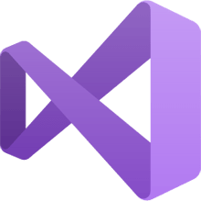


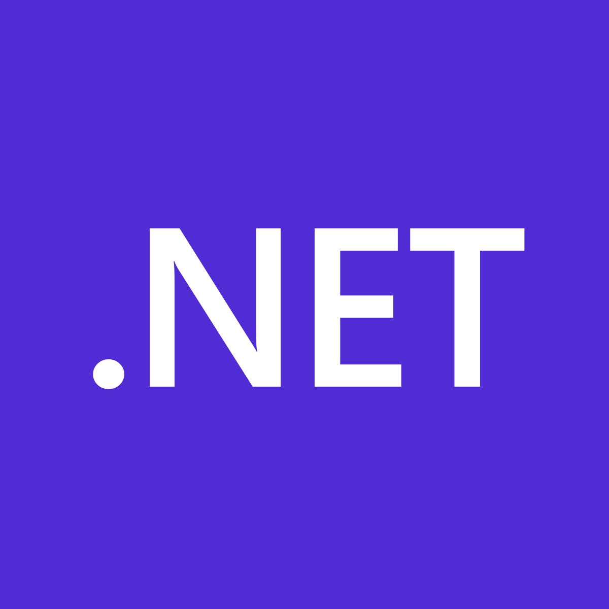
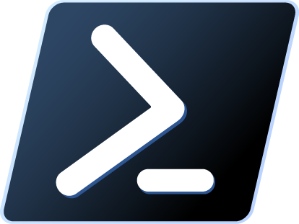
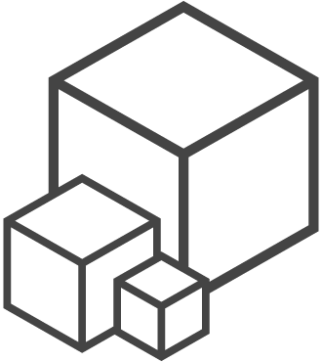
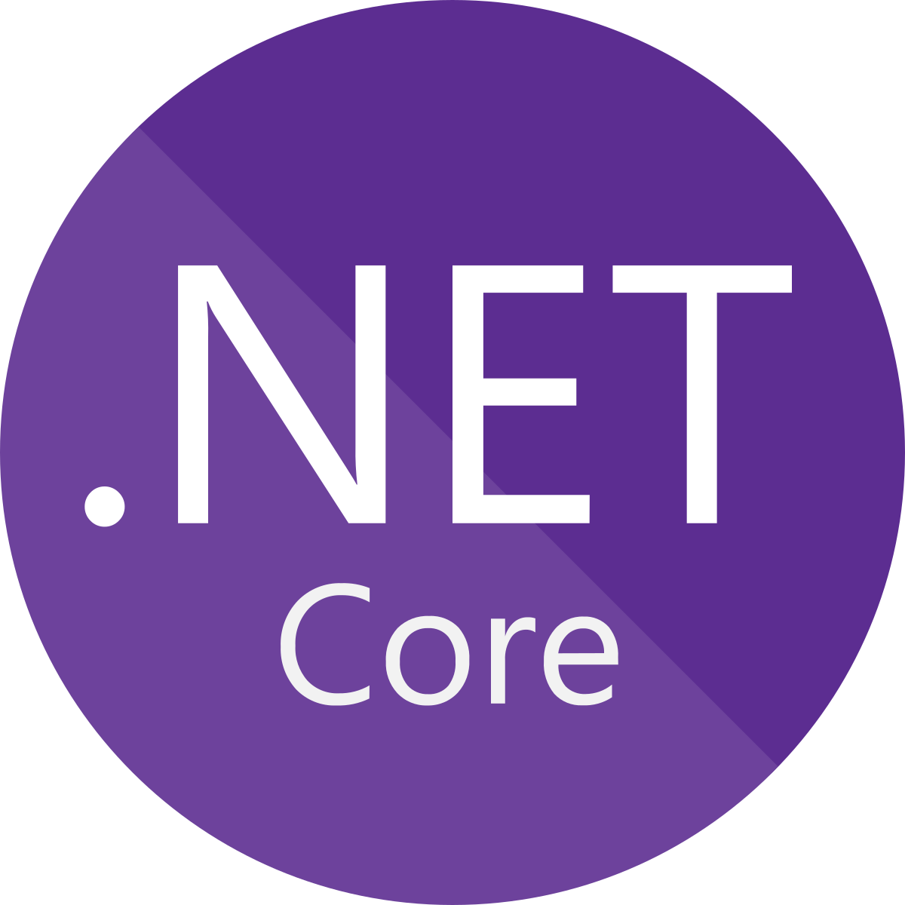
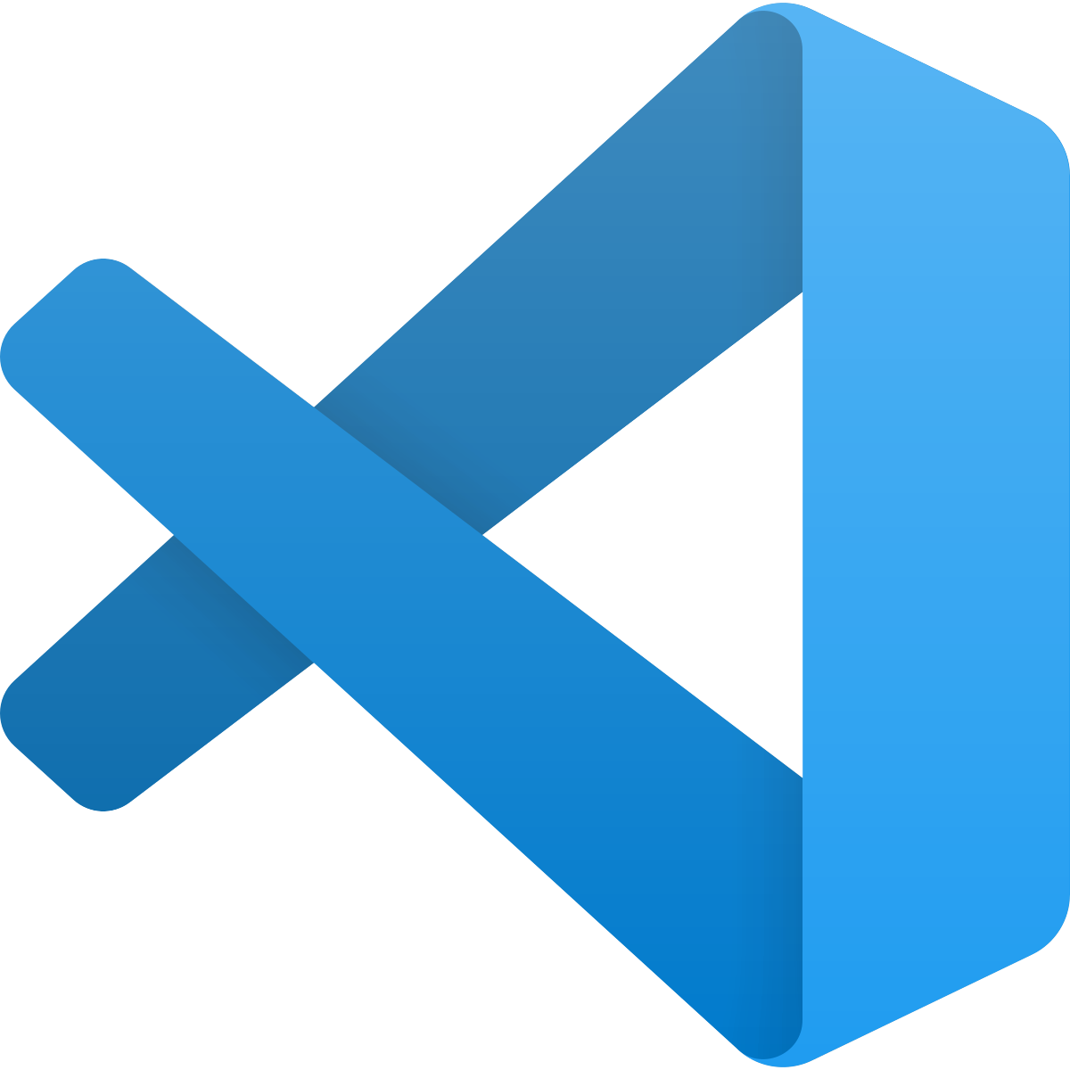
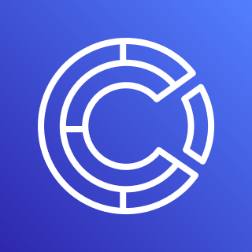
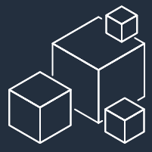
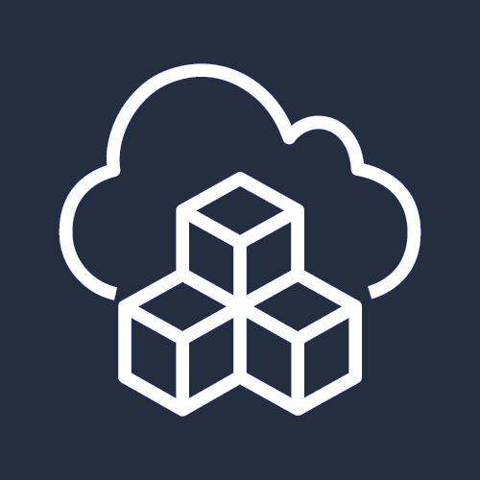
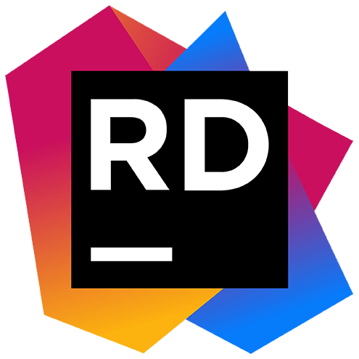
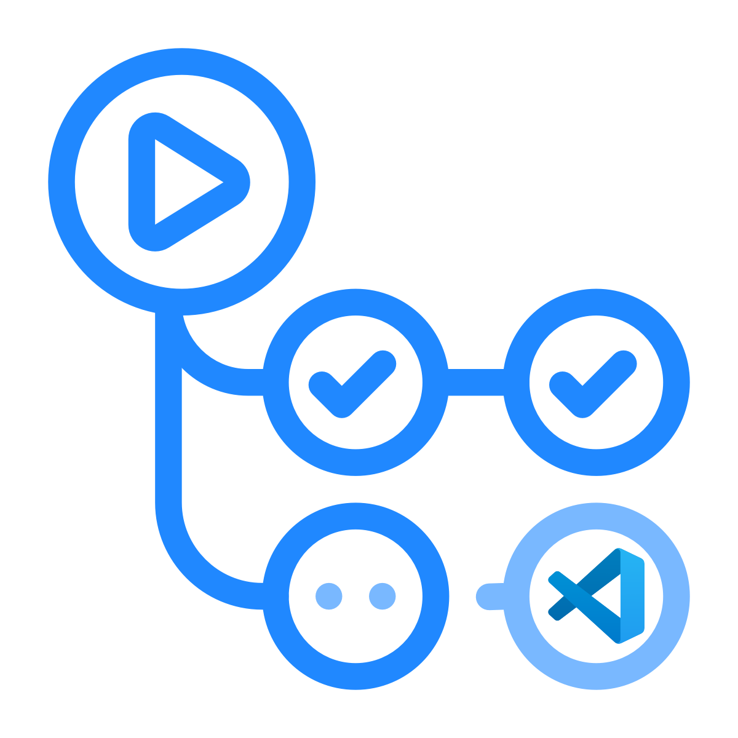

Development Tools
IDE Integration
Programmable SDK
Command Line Tools
CI/CD Integration
Migration / Modernization
Tools
AWS Toolkit for Visual Studio
AWS SDK for .NET
AWS Tools for Azure DevOps
App2Container
AWS Tools for PowerShell
‘dotnet’ CLI extensions
AWS Toolkit for Visual Studio Code
Amazon CodeCatalyst
Porting
Assistant
for .NET
AWS CLI
AWS SAM
AWS CDK for .NET
AWS Toolkit for Rider
GitHub Actions
Microservice Extractor
for .NET
Notes:
AWS has supported .NET and PowerShell for many years and makes available a collection of free tools and IDE integrations that you can use to develop, deploy, and manage your applications and their resources in the cloud.
Integrations with Visual Studio, Visual Studio Code, and JetBrains Rider make working with AWS services from within IDE environments easy and convenient.
To integrate calls to AWS services from within your applications, use the AWS SDK for .NET.
The SDK makes calling an AWS service API as simple as calling a method on an object.
For defining cloud infrastructure and resources for your applications, there’s also the AWS Cloud Development Kit or CDK.
With the CDK, you define your resources in the programming languages you use every day, for example C#, instead of using a declarative templating language such as YAML or JSON.
A rich collection of PowerShell modules wrapping AWS services is available for command line and scripting users, and you can also use .NET and PowerShell to write your serverless functions and applications for use with AWS Lambda.
For modern .NET, tooling packages are available that integrate with the dotnet command line interface.
The AWS Command Line Interface, or AWS CLI and the AWS Serverless Application Model, or SAM, CLI can also be used with .NET.
Today, many organizations and developers make use of continuous integration and deployment and AWS offers a suite of services you can use for build and deployment, and pipeline orchestration.
There’s also an integration for users with established CI/CD pipelines in Azure DevOps or GitHub actions looking to bridge that last mile to AWS. We also just recently announced Amazon Code Catalyst, an all-purpose software development service
You’ll also find free tools that can assist with application migration and modernization.
App2Container encapsulates your legacy application into a container, complete with the application dependencies.
The Porting Assistant for .NET can help you port your .NET Framework applications to .NET Core and .NET 5.
And finally, the Microservice Extractor for .NET helps with refactoring your monolithic MVC applications to a microservices architecture for better scale, more resiliency, and faster development.

Slide 8
How can I host my .NET application on AWS?

Slide 9

.NET Application Migration
How can I host my .NET application on AWS?
Target VM
or
Container / Serverless ?
VM
AWS Managed
or Self-Managed ?
Self
Amazon EC2

Slide 10
Amazon EC2
Virtual server instances in the cloud
CATEGORIES
CAPABILITIES
OPTIONS
Choice of processor (AWS, Intel, AMD)
Fast processors (up to 4.0 GHz)
High memory footprint (up to 24 TiB)
Instance storage (HDD and SSD)
Accelerated computing (GPUs and FPGA)
Networking (up to 100 Gbps)
Bare Metal
Size (Nano to 48xlarge – 192vCPU)
General purpose
Burstable
Compute intensive
Memory intensive
Storage (High I/O)
Dense storage
GPU compute
Graphics intensive
MORE THAN
Amazon EBS
Amazon Elastic Inference
400+
INSTANCE TYPES
for virtually every workload and business need
Notes:
1/ For all different kinds of workloads, we offer different capabilities, processors, platforms, instances, and more.
2/ All these options create the power of choice for our customers to select the best instances for their business needs.

Slide 11
AWS Graviton Processor
Best price performance in ec2
CAPABILITY
HOW MUCH FASTER?
Compute Performance
Floating-point performance
Cryptographic Workload Performance
Vector-instruction performance
25% better
2x higher
2x higher
35% higher
Notes:
For the best price performance option, look at Graviton, our ARM based instances
Regardless of what sort of workloads you are running, you can trust that you will get great perforamce gains

Slide 12
Hosting .NET Apps on Amazon EC2
Demo

Slide 13

.NET Application Migration
How can I host my .NET application on AWS?
Target VM
or
Container / Serverless ?
VM
AWS Managed
or Self-Managed ?
AWS Elastic Beanstalk
managed EC2
Self
Amazon EC2

Slide 14







AWS Elastic Beanstalk
A fully managed service for hosting web applications
myapp.com
AWS Cloud
Amazon Route 53
Availability Zone 1
Availability Zone 2
Highly available
Scalable
Provisioned automatically
VPC
Elastic Beanstalk
environment
Application load balancer
Auto Scaling Group
Web server
instances
Web server
instances
Notes:
We all want that our web applications are highly available and scalable.
OK, what we have to do to achieve this goal:
Add an application load balancer
That routes the request to web server instances in at least 2 Availability Zones (2 independent datacenters in the same region)
Add an auto scaling group to manage the addition or retirement of web server instances
That’s a lot of AWS resources to manage. This is where Elastic Beanstalk brings its value: it provisions and manages these resources for you. You still have access to the underlying resources as it is plain-old EC2 instances, Load Balancer and Auto Scaling Group

Slide 15
.NET Application Migration
How can I host my .NET application on AWS?
Target VM
or
Container / Serverless ?
.NET Framework or .NET ?
Container / Serverless
Rehost
VM
AWS Managed
or Self-Managed ?
AWS Elastic Beanstalk
managed EC2
Self
Amazon EC2

Slide 16

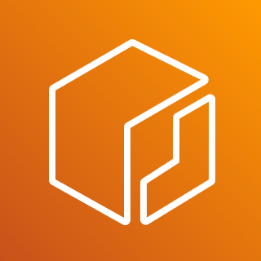
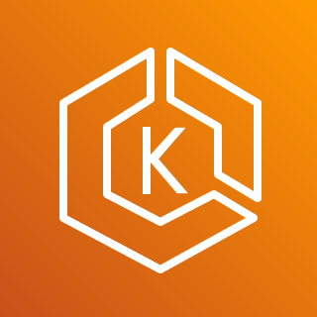
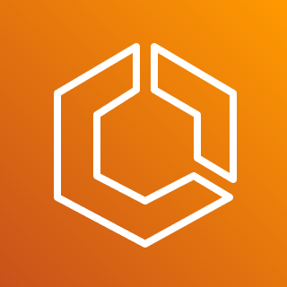
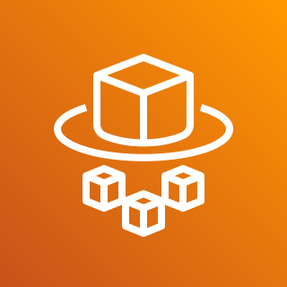





Storing container images with Amazon ECR
fully-managed container artifact registry
AWS Cloud
Amazon ECR
Docker and OCI compliant to pull anywhere
Push
Pull
Managed and scalable infrastructure
Highly available, high performance
Security with encrypted images and vulnerability scans
Authenticated access, centralized IAM control
On premises and other clouds
Amazon EKS
Amazon ECS
AWS Fargate
Amazon EC2
AWS App Runner
VPC
Availability Zone
Availability Zone
Availability Zone
Container images, Helm charts, OCI artifacts
Compute
Native integration to AWS orchestrators and compute
Notes:
NOTE: If you want to share more details on ECR components see the appendix slides.
SAY: Let’s unpack Amazon ECR and discuss some of the benefits of using it for your next container deployment.
SAY: ECR is Fully managed
Amazon Elastic Container Registry eliminates the need to operate and scale the infrastructure required to power your container registry.
SAY: ECR is Secure
Amazon Elastic Container Registry transfers your container images over HTTPS and automatically encrypts your images at rest. You can configure policies to manage permissions and control access to your images using AWS Identity and Access Management (IAM) users and roles without having to manage credentials directly on your EC2 instances.
SAY: ECR is Highly available
Amazon Elastic Container Registry has a highly scalable, redundant, and durable architecture. Your container images are highly available and accessible, allowing you to reliably deploy new containers for your applications.
SAY: ECR provides a simplified workflow
Amazon Elastic Container Registry integrates with Amazon ECS/EKS and the Docker CLI, allowing you to simplify your development and production workflows. You can easily push your container images to Amazon ECR using the Docker CLI from your development machine, and Amazon ECS/EKS can pull them directly for production deployments.

Slide 17

.NET Application Migration
How can I host my .NET application on AWS?
Target VM
or
Container / Serverless ?
.NET Framework or .NET ?
Container / Serverless
Rehost
VM
.NET Framework
AWS Managed
or Self-Managed ?
Serverless Containers ?
AWS Elastic Beanstalk
managed EC2
No
Self
Orchestration by
Kubernetes ?
No
Amazon EC2
Amazon ECS hosting managed Windows Containers

Slide 18

Amazon ECS
Powerful simplicity
CodePipeline
CodeCommit
CodeBuild
CodeDeploy
ECR
Team
CloudWatch
ALB
User
Application
App Mesh
ECS
CloudFormation
EC2
Notes:
If you are new to containers on AWS, a great first step could be ECS or Elastic Container Service
ECS is a highly scalable container management service and you can use it to run, stop, and configure your containers on a cluster.
With ECS, your containers are defined in a task definition that you use to run an individual task or task within a service. When I say service, I am referring to a configuration that you can use to run and maintain a specific number of tasks at the same time.
ECS has a ton of great features available out of the box but the most important one is the ability to autoscale depending on your load.
What technically happens with autoscaling turned on is that ECS creates two custom CloudWatch metrics and a target tracking scaling policy that attaches to your Auto Scaling group.
Amazon ECS then manages the scale-in and scale-out actions of the Autoscaling Group based on the load your tasks put on your cluster.
ECS is also quite cost-effective as containerizing applications requires smaller compute sizes than hosting applications in virtual machines.
As mentioned earlier, you can host all forms of applications on ECS, from adhoc tasks to enterprise scale solutions of any size.
And how this is done is that ECS manages clusters of EC2 instances that have container orchestration tools running on them. ECS has access to these tools to enable to patching of the instances as well scale and up down for you.

Slide 19
.NET Application Migration
How can I host my .NET application on AWS?
Target VM
or
Container / Serverless ?
.NET Framework or .NET ?
Container / Serverless
Rehost
VM
.NET Framework
AWS Managed
or Self-Managed ?
Serverless Containers ?
AWS Elastic Beanstalk
managed EC2
No
Self
Orchestration by
Kubernetes ?
No
Amazon EC2
Amazon ECS hosting managed Windows Containers
Amazon EKS hosting managed Windows Containers
Yes

Slide 20
Amazon EKS
Open flexibility
GitLab, Jenkins
GitHub
Jenkins
Flux
DockerHub/ ECR Public
Team
Prometheus, Grafana
[New AWS managed options for both]
ALB, NLB, NGINX, Traefik
User
Application
Istio, LinkerD, AWS App Mesh
AWS Controllers for Kubernetes (ACK)
EKS
Terraform
EC2
Notes:
We recognize that you might not be starting from scratch when you build on AWS container services. You may have chosen Kubernetes and have existing tooling. EKS gives you the ability to bring the services you want and build in a flexible environment.
If you are not familiar with Kubernetes, it is an open-source system for automating the deployment, scaling and management of containerized applications. What EKS does is
Runs and scales the Kubernetes control plane across multiple AWS Availability Zones to ensure high availability.
Automatically scales control plane instances based on load, detects and replaces unhealthy control plane instances, and it provides automated version updates and patching for them.
Kubernetes has been labeled as the de facto standard when it comes to building microservice based solutions, because of the exceptional reliability and stability built into the framework due to high fault tolerance clustering. There are plenty of other reasons why Kubernetes is as excellent choice for container orchestration, but those are some of them.
EKS is a managed version of Kubernetes that abstracts having to install, operate, and maintain your own Kubernetes control plane or nodes.
When choosing between EKS and ECS for container orchestration, the largest thing to consider is how you want services such as networking or other components handled. ECS relies on AWS-provided services like Application Load Balancer, Route 53 and others, while EKS handles all these mechanisms internally, as these are core components of Kubernetes.
EKS also runs up-to-date versions of the open-source Kubernetes software, so you can use all of the existing plugins and tooling from the Kubernetes community. Applications that are running on Amazon EKS are fully compatible with applications running on any standard Kubernetes environment, no matter whether they're running in on-premises data centers or public clouds. This means that you can easily migrate any standard Kubernetes application to Amazon EKS without any code modification.
Of course, if you want to use EKS with all of the AWS services, you can do that too, and we continue to prioritize Kubernetes-friendly integrations with innovations like ACK (AWS controllers for Kubernetes).

Slide 21
.NET Application Migration
How can I host my .NET application on AWS?
Target VM
or
Container / Serverless ?
.NET Framework or .NET ?
Container / Serverless
Rehost
VM
.NET Framework
AWS Managed
or Self-Managed ?
Serverless Containers ?
AWS Elastic Beanstalk
managed EC2
Yes
AWS Fargate with ECS managed Windows containers
No
Self
Orchestration by
Kubernetes ?
No
Amazon EC2
Amazon ECS hosting managed Windows Containers
Amazon EKS hosting managed Windows Containers
Yes

Slide 22
AWS Fargate
Serverless Compute Engine For Containers
CodePipeline
CodeCommit
CodeBuild
CodeDeploy
ECR
Team
CloudWatch
ALB
User
Application
App Mesh
ECS
CloudFormation
Fargate
Notes:
So with both ECS and EKS there is still some management of the servers or instances of EC2, not as much as owning the EC2 instances outright, but it isn’t a completely turnkey approach. If you are looking for more set and forget and customize if you need in the future, there is another offering for those services, and that is AWS Fargate. AWS Fargate is a technology you can use with ECS and EKS to run your containers without having to manage them at all, so no provisioning, configuration, or scale required.
When you run your Amazon ECS tasks and services with the Fargate launch type or a Fargate capacity provider, you package your application in containers, specify the Operating System, CPU and memory requirements, define networking and IAM policies, and launch the application. Each Fargate task has its own isolation boundary and does not share the underlying kernel, CPU resources, memory resources, or elastic network interface with another task.
And since all of the management is done for you, you have the ability to tap into great cost savings as you only pay for the resources you consume while they are running, so no overhead of an always on EC2 instance. This also allows more flexibility to scale up or down, again bringing more cost optimization

Slide 23
.NET Application Migration
How can I host my .NET application on AWS?
Target VM
or
Container / Serverless ?
.NET Framework or .NET ?
Linux or Windows ?
Containerized Apps / Serverless / Static Hosting?
Container / Serverless
.NET
Linux
Rehost
AWS App Runner
VM
.NET Framework
Serverless Containers ?
Containerized applications
AWS Managed Containerized Web/API Applications ?
Serverless Containers ?
Windows
AWS Managed
or Self-Managed ?
Yes
AWS Elastic Beanstalk
managed EC2
Yes
Yes
No
AWS Fargate with ECS managed Windows containers
No
No
Self
Orchestration by
Kubernetes ?
Orchestration by
Kubernetes ?
Orchestration by
Kubernetes ?
No
No
Amazon EC2
Amazon ECS hosting managed Windows Containers
No
Amazon ECS hosting managed Linux Containers
Yes
AWS Fargate with ECS managed Linux containers
AWS Fargate with EKS managed Linux containers
Amazon EKS hosting managed Windows Containers
Yes
Yes
Amazon EKS hosting managed Linux Containers

Slide 24
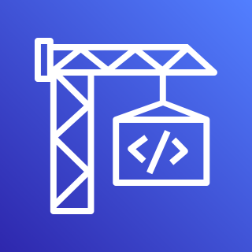

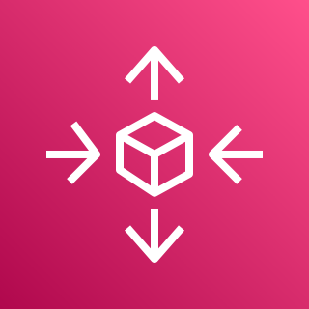
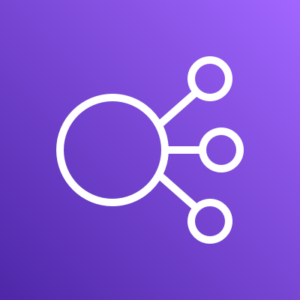
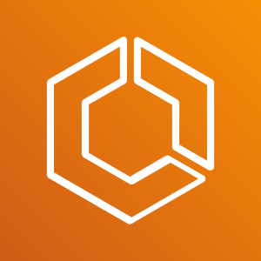
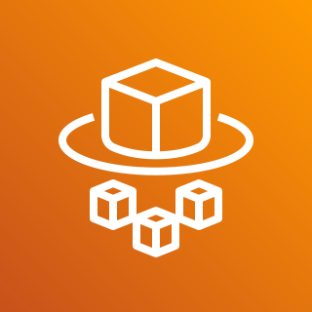
AWS App Runner
Fully managed service for Web application and API hosting Services
AWS App Runner
AWS CodeBuild
AWS Auto Scaling
Elastic Load Balancing
Serverless Platform
ECS
provides a highly abstracted
and simple managed experience for running
web applications and API hosting services
AWS Fargate
Notes:
But, when they get to the cloud they start finding that there's all these different infrastructure layers that they have to learn.
Starting from the bottom with the compute layer they would have to learn Fargate to provision, configure, or scale clusters of virtual machines.
To run containers they may then have to be able to operate ECS as an orchestrator
They need to have a load balancer for their applications to distribute and make their processing efficient. So now, they're learning and equipping around ELBs.
Not to forget, they need to handle that scaling piece that we just called out, they've got to determine those metrics what they're going to scale on and off of and figure out what their application needs for that for that workload and then CICD pipelines and other operational pieces.
So we often hear customers say, hey, there's a big learning curve here.
“I have to learn a lot about these infrastructure services when I'm really focused on my web application, my back end servers, I want to go and deploy these apps.
How can I skip the hassle of learning all these specifics? “

Slide 25
Hosting .NET Apps on AWS App Runner
Demo

Slide 26

.NET Application Migration
How can I host my .NET application on AWS?
Refactor
Target VM
or
Container / Serverless ?
.NET Framework or .NET ?
Linux or Windows ?
Containerized Apps / Serverless / Static Hosting?
Serverless Functions
AWS Lambda
Container / Serverless
.NET
Linux
Rehost
VM
.NET Framework
Applications
Windows
Serverless Containers ?
AWS Managed Containerized Web/API Applications ?
AWS Managed
or Self-Managed ?
Serverless Containers ?
Yes
AWS Elastic Beanstalk
managed EC2
Yes
Yes
No
AWS App Runner
AWS Fargate with ECS managed Windows containers
No
No
Replatform
Self
Orchestration by
Kubernetes ?
Orchestration by
Kubernetes ?
Orchestration by
Kubernetes ?
No
No
Amazon EC2
Amazon ECS hosting managed Windows Containers
No
Amazon ECS hosting managed Linux Containers
Yes
AWS Fargate with ECS managed Linux containers
AWS Fargate with EKS managed Linux containers
Amazon EKS hosting managed Windows Containers
Yes
Yes
Amazon EKS hosting managed Linux Containers

Slide 27
AWS Lambda
Serverless event-driven code execution
AWS manages
Customer manages
Least
AWS Lambda
Serverless functions
Data source integrations
Physical hardware, software, networking, and facilities
Provisioning
Application code
AWS Fargate
Serverless containers
Container orchestration, provisioning
Cluster scaling
Physical hardware, host OS/kernel, networking, and facilities
Application code
Data source integrations
Security config and updates
Network config
Management tasks
What you manage
Amazon ECS/EKS Container-management -as-a-service
Container orchestration control plane
Physical hardware software, networking, and facilities
Application code
Data source integrations
Work clusters
Security config and updates, network config, firewall, management tasks
Amazon EC2
Infrastructure-as-a-Service
Application code
Data source integrations
Scaling
Security config and updates
Network config
Management tasks
Provisioning, managing scaling and patching of servers
Physical hardware software, networking, and facilities
Most
Notes:
For many customers – their first decision when it comes to application architecture is compute.
1/ You can start at the very bottom with EC2 and have access to all the knobs you want to manage or you could go completely serverless with lambda where you’re focusing just on your application.
2/ So the layers of abstractions available to you with AWS is super empowering because your teams have the choice to pick the layer of abstraction they’re most comfortable with and we will provide you the tools, services, and APIs necessary to help you build your application
When you’re looking to optimize for your time to market and pace of innovation – we always suggest you start with Lambda because you’ll manage as little as possible.
It is more than likely you have heard at least the name AWS Lambda, and may even have a rough idea of what the service is. If not, AWS Lambda is a service that allows you to run a function or smaller piece of functionality on demand without the need to management the underlying infrastructure at all. The phrase commonly used in the industry is “serverless” as the thought is we think about our code and the server less. Regardless of your thoughts on the phrase, the ability to just focus on the functionality you are trying to light up is quite valuable.
One no other scenario is more interesting than when you want to build an event-driven solution. When I say event-driven, I think about how the apps we build often need to act on some event, maybe a database record gets updated, a file gets dropped in a storage bucket, or even at a particular time of the day. This scenario is the perfect time to use AWS Lambda as you can configure these triggers right in the AWS console, and seamlessly see executions of your code when those use-cases are hit.
Another great example of when to use AWS Lambda are when scale is of the upmost importance. Imagine being a retail company with an ecommerce store on Black Friday in the United States and your bottom-line is immediately dependent on how your website reacts to demand of customers. AWS Lambda scale automatically based on load, so you can rest assured that your app will be scalable and robust when you need it most.
The number one benefit to most when it comes to serverless technologies like AWS Lambda at the pricing model. Since you only pay for when your AWS Lambda functions run, you get an exception value as you truly pay for when your app is actively running. We have conversation with customers all the time saying they were initially shocked at how low their AWS Lambda consumption bill is when they first started using the technology.
And as I mentioned earlier, you have easily accessible metrics and execution telemetry data right from the AWS console for your running AWS Lambda functions. This is incredibility helpful to get an idea of how your apps are behaving in the wild.

Slide 28
Hosting .NET Apps on AWS Lambda
Demo

Slide 29

.NET Application Migration
How can I host my .NET application on AWS?
Refactor
Target VM
or
Container / Serverless ?
.NET Framework or .NET ?
Linux or Windows ?
Containerized Apps / Serverless / Static Hosting?
Serverless Functions
AWS Lambda
Container / Serverless
Static Hosting
.NET
Linux
AWS Amplify
Rehost
VM
.NET Framework
Applications
Windows
Serverless Containers ?
AWS Managed Containerized Web/API Applications ?
AWS Managed
or Self-Managed ?
Serverless Containers ?
Yes
AWS Elastic Beanstalk
managed EC2
Yes
Yes
No
AWS App Runner
AWS Fargate with ECS managed Windows containers
No
No
Replatform
Self
Orchestration by
Kubernetes ?
Orchestration by
Kubernetes ?
Orchestration by
Kubernetes ?
No
No
Amazon EC2
Amazon ECS hosting managed Windows Containers
No
Amazon ECS hosting managed Linux Containers
Yes
AWS Fargate with ECS managed Linux containers
AWS Fargate with EKS managed Linux containers
Amazon EKS hosting managed Windows Containers
Yes
Yes
Amazon EKS hosting managed Linux Containers

Slide 30








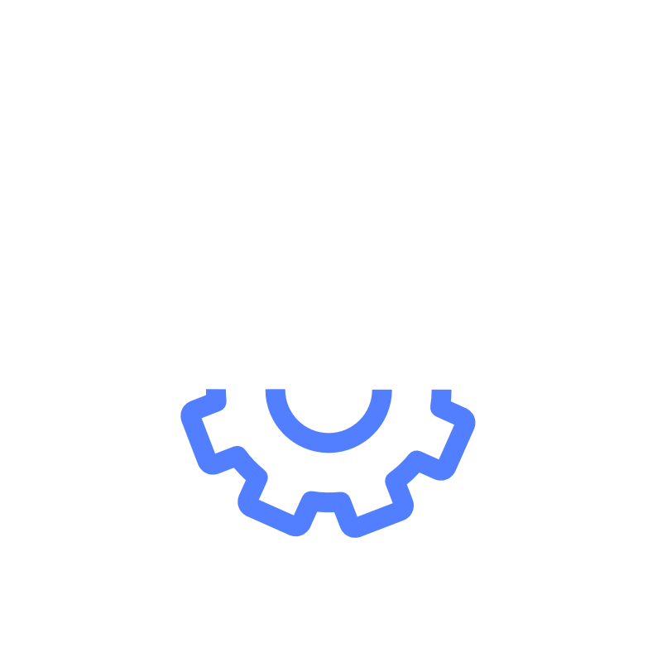



BUILD with AWS Amplify
Full-stack developer experience
BUILD
Feature categories
Authentication
DataStore
Storage
API (GraphQL & REST)
Functions Geo
Analytics
PubSub
Predictions
Interactions
Notifications Extensibility
Configure AWS backends fast
Seamlessly connect frontends
CLI
Studio
Libraries
Powered by AWS services such as AWS AppSync (GraphQL API) and Amazon Cognito (Authentication)
Notes:
Configure backends fast Use Amplify Studio and CLI's intuitive workflows to set up scalable AWS backends with authentication, storage, data, and other common use cases.
Amplify Studio – New Amplify Studio (now in GA) provides a visual interface to configure and maintain your app backend outside the AWS console, build a frontend UI, and quickly bind the two together. Easily configure your backend data model, authentication, authorization, and more. All backend resources created by Amplify Studio are usable with the Amplify CLI.
Amplify CLI toolchain - The Amplify Command Line Interface (CLI) is a toolchain to configure and maintain your app backend from your local desktop. Configure cloud functionality using the CLI's interactive workflow and intuitive use cases such as auth, storage, API. Test features locally and deploy multiple environments. All configured resources are available to customers as infrastructure-as-code templates enabling better team collaboration and easy integration with Amplify's CI/CD workflow.
Seamlessly connect front ends Use the Amplify libraries in your web, Android, and iOS apps to connect to new and existing AWS resources in just a few lines of code.
LibrariesJavaScript >> iOS >> Android >> Flutter >> AWS Amplify offers use case-centric open source libraries in the Amplify Framework to build cloud powered mobile and web apps. Amplify libraries are powered by AWS services and can be used with new backends created with the Amplify CLI and admin UI, or your existing AWS backend.
Authentication Create seamless on-boarding flows with a fully-managed user directory and pre-built sign-up, sign-in, forgot password, and multi-factor auth workflows. Amplify also supports login with a social provider such as Facebook, Google Sign-In, or Login With Amazon and provides fine grained access control to mobile and web applications. Powered by Amazon Cognito.
DataStore Use a multi-platform (iOS/Android/React Native/Web) on-device persistent storage engine that automatically synchronizes data between mobile/web apps and the cloud, powered by GraphQL. DataStore provides a programming model for leveraging shared and distributed data without writing additional code for offline and online scenarios, which makes working with distributed, cross-user data just as simple as working with local-only data. Powered by AWS AppSync.
Analytics Understand the behavior of your web, iOS or Android users. Use auto tracking to track user sessions and web page metrics or create custom user attributes and in-app metrics. Get access to real time data stream and analyze the data for customer insights and build data driven marketing strategies to drive customer adoption, engagement, and retention. Powered by Amazon Pinpoint and Amazon Kinesis.
API Make secure HTTP requests to GraphQL and REST endpoints to access, manipulate, and combine data from one or more data sources such Amazon DynamoDB, Amazon Aurora Serverless, and your custom data sources with AWS Lambda. Amplify enables you to easily build scalable applications that require real-time updates, local data access for offline scenarios, and data synchronization with customizable conflict resolution when devices are back online. Powered by AWS AppSync and Amazon API Gateway.
Functions Add a Lambda function to your project which you can use alongside a REST API or as a datasource in your GraphQL API using the @function directive in the Amplify CLI. You can update the Lambda execution role policies for your function to access other resources generated and maintained by the CLI, using the CLI. Amplify CLI enables you to create, test and deploy Lambda functions across various runtimes and once a runtime is selected, you can select a function template for the runtime to help bootstrap your Lambda function. Hosting >> link to amplify/hosting page to replace amplify/console pageBuild and deploy fullstack serverless web applications from the Amplify console. A fullstack serverless app consists of a backend built with cloud resources such as GraphQL or REST APIs, file and data storage, and a frontend built with single page application frameworks such as React, Angular, Vue, or Gatsby.
Geo Add location-aware features like maps and location search to your JavaScript-based web app in minutes. Amplify Geo includes pre-integrated map UI components (based on the popular MapLibre open-source library) and it updates the Amplify Command Line Interface (CLI) tool with support for provisioning all required cloud location services. You can customize embedded maps to match your app’s theme, or choose from many community-developed MapLibre plugins for more flexibility and advanced visualization options. Powered by Amazon Location Service.
Interactions Build interactive and engaging conversational bots with the same deep learning technologies that power Amazon Alexa with just a single line of code. Create great user experiences through chat bots when it comes to tasks such as automated customer chat support, product information/recommendations or streamlining common work activities etc. Powered by Amazon Lex.
Predictions Enhance your app by adding AI/ML capabilities. You can easily achieve use cases like text translation, speech generation from text, entities recognition in image, interpretation of text, and transcribing text. Amplify enables simplified orchestration of advanced use cases like uploading images for automatic training and using GraphQL directives for chaining multiple AI/ML actions. Powered by Amazon Machine Learning services, such as Amazon Sagemaker.
PubSub Pass messages between your app instances and your app's backend creating real-time interactive experiences. Amplify provides connectivity with cloud-based message-oriented middleware. Powered by AWS IoT services and Generic MQTT Over WebSocket Providers.
Push notifications Improve customer engagement by using marketing and analytics capabilities. Leverage customer insights to segment and target your customers more effectively. You can tailor your content and communicate through multiple channels including email, texts as well as push notifications. Powered by Amazon Pinpoint.
Storage Store and manage user generated content such as photos, videos securely on device or in the cloud. The AWS Amplify Storage module provides a simple mechanism for managing user content for your app in public, protected or private storage buckets. Leverage cloud scale storage so that you can easily take your application from prototype to production. Powered by Amazon S3.
Extensibility – Amplify’s new extensibility features give developers the flexibility to customize their AWS backend and deployment capabilities. Reconfigure Amplify-generated backend resources to optimize for specific use cases, or modify Amplify's deployment operations to comply with your enterprise DevOps guidelines as your needs evolve.

Slide 31
.NET Application Migration
How can I host my .NET application on AWS?
Refactor
Target VM
or
Container / Serverless ?
.NET Framework or .NET ?
Linux or Windows ?
Containerized Apps / Serverless / Static Hosting?
Serverless Functions
AWS Lambda
Container / Serverless
Static Hosting
.NET
Linux
AWS Amplify
Rehost
VM
.NET Framework
Applications
Windows
Serverless Containers ?
AWS Managed Containerized Web/API Applications ?
AWS Managed
or Self-Managed ?
Serverless Containers ?
Yes
AWS Elastic Beanstalk
managed EC2
Yes
Yes
No
AWS App Runner
AWS Fargate with ECS managed Windows containers
No
No
Replatform
Self
Orchestration by
Kubernetes ?
Orchestration by
Kubernetes ?
Orchestration by
Kubernetes ?
No
No
Amazon EC2
Amazon ECS hosting managed Windows Containers
No
Amazon ECS hosting managed Linux Containers
Yes
AWS Fargate with ECS managed Linux containers
AWS Fargate with EKS managed Linux containers
Amazon EKS hosting managed Windows Containers
Yes
Yes
Amazon EKS hosting managed Linux Containers

Slide 32
How can I containerize my .NET application?

Slide 33
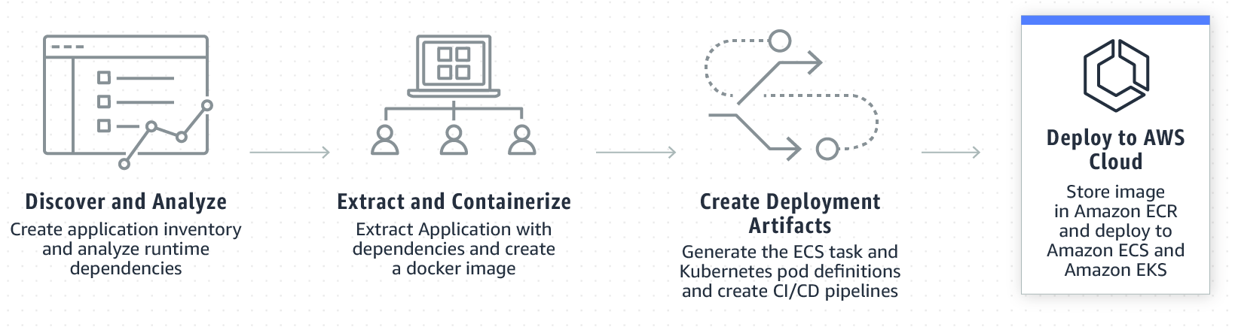
App2Container
App2Container
Containerize and migrate existing applications
Streamline operations by containerizing your existing applications and standardize on a single set of tooling for monitoring, operations, and software delivery.
Analyze your applications and automatically generate a container image that is configured with the correct dependencies, network configurations, and deployment instructions for ECS or Kubernetes.
Easily deploy an existing application on the cloud that is provisioned with the correct networking and security configurations.
https://aws.amazon.com/app2container
Notes:
App2Container enables you to containerize existing applications and migrate them to Amazon Elastic Container Service and Amazon Elastic Kubernetes Service, complete with all the needed dependencies and network configuration.

Slide 34
How can I move from .NET Framework to .NET?

Slide 35
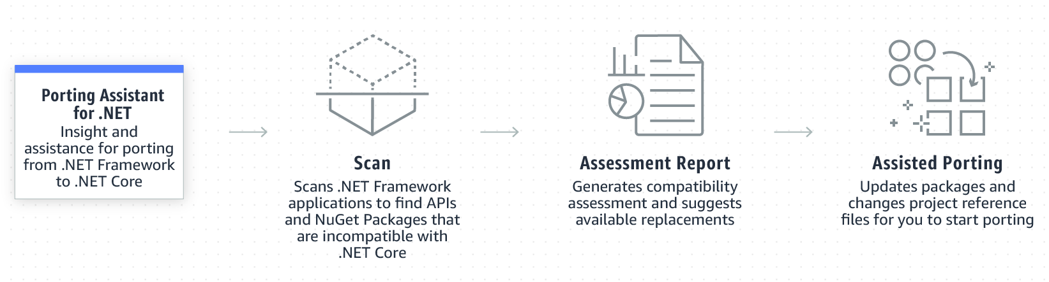
Porting Assistant for .NET
Porting
Assistant
for .NET
Insight and assistance for porting from .NET Framework to .NET Core/.NET 5+
Scan your entire .NET Framework application portfolio to generate .NET Core compatibility assessment reports. This makes it easy to prioritize applications for porting based on the level of effort required.
Identify incompatible .NET Core APIs and packages from your .NET Framework applications, and find known replacements reducing the manual effort of searching for replaceable packages and APIs.
https://aws.amazon.com/porting-assistant-dotnet
Notes:
For those of you with .NET Framework applications, the Porting Assistant for .NET is a free graphical tool that analyzes your application to determine its compatibility with .NET Core or higher.
Going beyond a compatibility report, the Porting Assistant can also automatically port your project files, and update NuGet package dependencies for you, including suggesting compatible replacements.
It offers a real helping hand to when modernizing your applications from .NET Framework onto .NET Core, and .NET 5 or higher.
The Porting Assistant is available as a standalone application or as an extension for Visual Studio, available on the Visual Studio marketplace.

Slide 36
How can I break my .NET monolith?

Slide 37
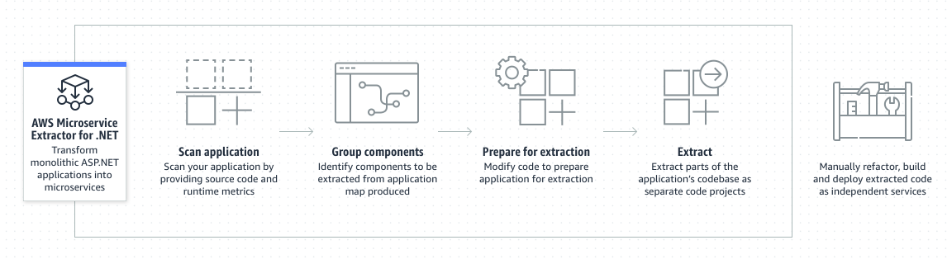
Microservice Extractor for .NET
Microservice Extractor for .NET
Simplify refactoring .NET applications
Quickly identify applications components to refactor into smaller services using a single visualization that shows each component's metrics and dependencies.
Label the visualization to associate code with business processes, making it easier to refactor following Domain Driven Design.
Refactor monolithic codebases into smaller code projects for teams to independently develop, build, deploy, and operate.
https://aws.amazon.com/microservice-extractor/
Notes:
The Microservice Extractor for .NET is a free tool that helps simplify and automate parts of the process involved in refactoring ASP.NET monolithic applications into independent services.
Once extracted, those services can be independently scaled when they’re deployed to the cloud.
Development teams working on the services are then also able to develop and deploy with increased agility and flexibility.
The tool analyzes source code and runtime metrics to create a visual representation of your application and its dependencies, and assists in code refactoring and extraction of the codebase into separate projects.
It also updates the original monolithic codebase for you, to make calls to the extracted microservice.

Slide 38
Modernizing inside Visual Studio

Slide 39
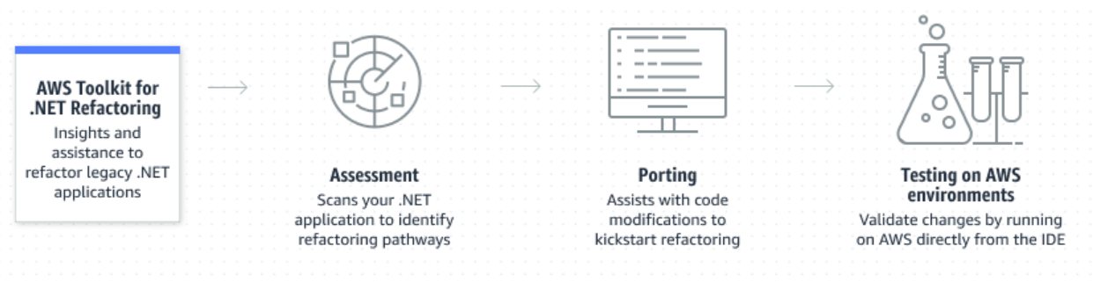
AWS Toolkit for .NET Refactoring
AWS Toolkit
for .NET Refactoring
Modernizing without leaving the IDE
Properly assess your existing .NET Framework applications and build a rich report to share with technical and business stakeholders
Augment coding changes required to modernize with analyzers and translation engines
Seamlessly deploy ported applications to AWS in a containerized way
https://docs.aws.amazon.com/tk-dotnet-refactoring/
Notes:
The Microservice Extractor for .NET is a free tool that helps simplify and automate parts of the process involved in refactoring ASP.NET monolithic applications into independent services.
Once extracted, those services can be independently scaled when they’re deployed to the cloud.
Development teams working on the services are then also able to develop and deploy with increased agility and flexibility.
The tool analyzes source code and runtime metrics to create a visual representation of your application and its dependencies, and assists in code refactoring and extraction of the codebase into separate projects.
It also updates the original monolithic codebase for you, to make calls to the extracted microservice.

Slide 40
Wrap up

Slide 41




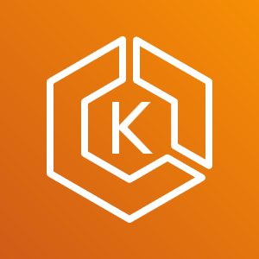
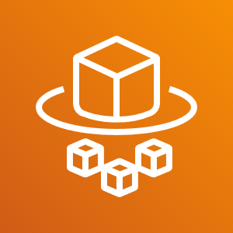
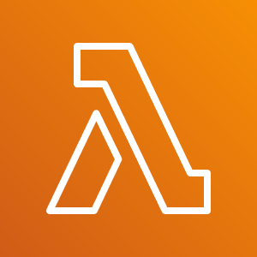
AWS Compute Services for .NET
.NET Framework
Amazon EC2
AWS Elastic Beanstalk
Amazon Lightsail
Amazon Elastic Container Service
Amazon Elastic Container Service for Kubernetes
AWS Fargate
AWS App Runner
AWS Lambda
.NET
Notes:
So depending on your needs and level of control, you have the entire spectrum with AWS.
Whether you want to own the entire environment your .NET apps run on all the way to you just want some code to run, the options are limitless.

Slide 42
Don’t forget the most important key takeaway
.NET

Slide 43

List of interesting links, click away!!!
Isaac Levin
Follow me on Twitter/Twitch/GitHub
@isaacrlevin

